Slide 1
Case Study for Young Data Scientist – Oct’17
Rare Disease Prediction
Version 1.0
New Delhi | +91 124 679 7000

Slide 2
Problem Scenario
An insurance company, LifeSure, based in Germany, provides insurance coverage to its clients. It provides financial protection against “rare” life threatening diseases. These diseases incur high costs of treatment, with a low occurrence rate.
Last year, the company has tested 20k residents in the city of Augsburg, Bavaria to assess the incidence of a rare disease “XYZ Syndrome”. During the survey, the company also collected different types of profile and medical examination results of every resident.
This year, LifeSure has hired a Data Scientist, to build a predictive model which can detect whether a resident will be affected with the rare disease or not. They intend to use the model on 50k newer residents, using their profile and medical examination results.
They have consolidated all the information required to build the predictive model. These variables have been de-identified due to regulatory restrictions in Germany.
We now need you to predict the “incidence of occurrence – 1 for Yes and 0 for No” among 50k residents in the “SUBMISSION” dataset
Notes:
What could be the potential reasons for non-consistancy; Which data is required to answer the company concern.

Slide 3
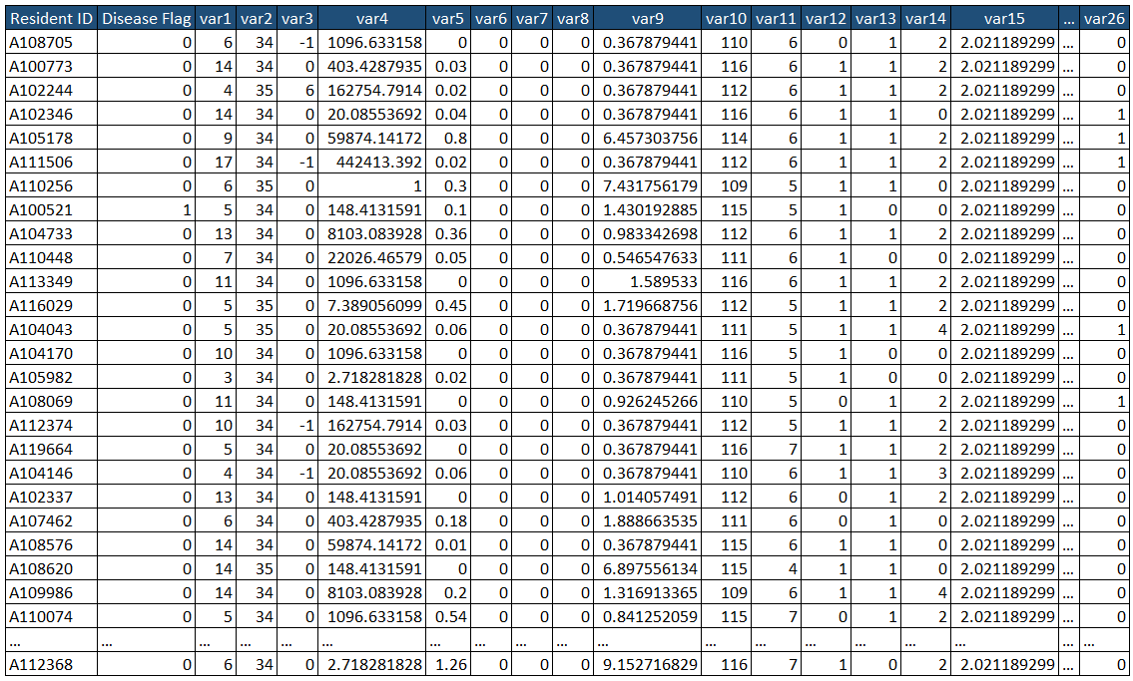
The following are sample records from the “TRAINING” and “TEST” datasets provided to you
This column is blank in the SUBMISSION dataset
Dataset Features:
Resident ID | Unique identifier for each resident
Disease flag | Rare disease binary flag of occurrence, where 1 means affected and 0 means non-affected
Var1 to var26 | Variables provided for each resident of different types – Numeric, Ordinal and Categorical
Notes:
The company provided the information about the agent transaction / demographic info of agents

Slide 4
You will be evaluated based on “AUC” metric on Test data
Analyze and manipulate the “TRAINING” dataset to suit modeling needs
Use the “TRAINING” dataset to create a model for predicting the occurrence of “Rare Disease”
Predict “Disease occurrence” for each account in the “SUBMISSION” dataset
Your solution should be submitted to us in two sections - Section A (Data Analysis) & Section B (Model results)
Notes:
The Model is organized as follows

Slide 5
Submitting “Section A”
In Section A, please provide your findings and justification on the below topics -
Quality checks performed / Errors found: Please report any potential errors / inaccuracies in the training dataset
Data preprocessing steps: Please provide potential data aggregations / transformations performed including how the quality checks from section 1 are dealt with
Key observations / Trends: Please provide any information on your key observations / insights from the datasets
Model choice explanation: Please justify the usage of a particular model for the dataset provided
Expected error for submission: Please provide the expected error for submission file
Top 5 most significant variable in model: Please mention the 5 most significant features in the dataset wrt their predictive power
Please submit your thoughts in word/PPT/Excel on the following via email details provided -
Ensure that you follow the file naming convention for submission of your document

Slide 6
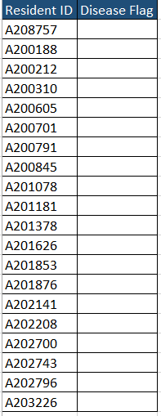
Submitting “Section B”
Update the “SUBMISSION” dataset with your predicted “Disease occurrence” for each resident, in the column “Disease flag” (see below table for details)
Predictions for the submission dataset are to be submitted in a csv file only with the header row included – please follow file naming convention given below
Include any other supporting material while making your submissions (Codes, Model file, images)
“Submission.csv” File Structure
Update column with your prediction
Save the filename as “Submission.csv”
Ensure that you follow the file naming convention for submission of your document

Slide 7
File Naming convention for Sections A and B
File naming Instructions
Update your response files for both sections to the following naming convention before submitting
File naming convention: FirstName_LastName_ddmmyyyy; For example, for Prakash Kumar with date of birth 10 Feb. 1987
Section A submission should be named Prakash_Kumar_10021987.pptx (or ppt/doc/docx/xls/xlsx)
Section B submission should be named Prakash_Kumar_10021987.csv
In case you only use a first name, use FNU in place of last name Prakash_FNU_10021987.csv
Please recheck FILE NAME before submitting!!!
Good Luck!

